Slide 1
Capturing Requirements Through
Use-Cases
Examples
‹#›
Notes:
‹#›

Slide 2
Subsystems
Admission Subsystem
Registration and Coursework Subsystem
Fees and Scholarships Subsystem
Exam Subsystem
Hall Subsystem
Library Subsystem
HR Subsystem
Salary, Leave and Holiday Subsystem
Departmental Subsystem
Etc.
‹#›

Slide 3
Admission Subsystem Actors
Applicant
Examinee
Accepted Student
Question Setter
Question Moderator
Invigilator
Examiner
Exam Controller
Exam Control Office Employee
Registrar
Accounts section employee
Bank
Health Complex employee
Health Complex Doctor
Time
Others
‹#›

Slide 4
Use-Cases for Admission Subsystem
Use-Case Name | Actors
Distribute Form | Applicant, Accounts section Employee
Submit Form | Applicant, Accounts section Employee
Sort | Exam Control office employee
Assign Question Setter | Exam Controller, Teacher
Assign Question Moderator | Exam Controller, Teacher
Assign Invigilator | Exam Controller, Teacher, Staff
Assign Examiner | Exam Controller, Teacher
Sit for exam | Examinee
Guard Exam | Invigilator
‹#›

Slide 5
Use-Cases for Admission Subsystem
Use-Case Name | Actors
Set Question | Question Setter
Moderate Question | Question Moderator
Examine | Examiner
Prepare Result | Exam Control Office Employee
View Result | All
Give Choice | Accepted Students
Sort out choice | Exam Control Office Employee
Perform Medical Checkup | Accepted student, Med Officer, Med Employee
Select from Waiting List | Time, Exam Control Office Employee
‹#›

Slide 6
Use-Cases for Registration and Coursework Subsystem
Use-Case Name | Actors
Pay Fee | Student, Registrar Office, Bank Teller, Hall Clerk
Register | Student, Adviser
Prepare Student List | Registrar Office
View Student List | Teacher, Lab Attendant, Exam Control Office
‹#›

Slide 7
Use-Cases for Registration and Coursework Subsystem
Use-Case Name | Actors
Issue Instrument | Student, Lab Attendant
Return Instrument | Student, Lab Attendant
Post Notice | Teacher, Head
View Notice | Teacher, Student
‹#›

Slide 8
Use-Cases for Registration and Coursework Subsystem
Use-Case Name | Actors
Assign Teacher | BUGS, Teacher
Prepare Routine | Routine Committee, BUGS
Send Routine | Routine Committee, Head
View Routine | Student, Teacher, Lab Attendant, Others
Attend Class | Student, Teacher
Take Class Test | Teacher
Sit for Class Test | Student
Update Class Test Marks | Teacher
View Class Test Marks | Student, Head
‹#›

Slide 9
Use-Cases for Exam Subsystem
Use-Case Name | Actors
Assign Examiner | BUGS, Teacher
Assign Question Scrutinizer | BUGS
Assign Scrutinizer | BUGS
Set Question | Teacher
Scrutinize Question | Teacher, Head
Print Question | Exam Control Office
Set Schedule | Exam Control Office
View Schedule | Student, Teacher, Others
Propose change in schedule | Student, Teacher
‹#›

Slide 10
Use-Cases for Exam Subsystem
Use-Case Name | Actors
Update Schedule | Exam Control Office
Make Sit Plan | Exam Control Office
Prepare exam guard schedule | Exam Control Office, Teacher
Sit for Exam | Student
Guard Exam | Teacher, Exam Control Office
Mark Exam Papers | Teacher
Scrutinize | Teacher
Ask for Re-scrutiny | Student, Teacher, Head
‹#›

Slide 11
Use-Cases for Exam Subsystem
Use-Case Name | Actors
Prepare Grade-sheet | Teacher, Head, Exam Control Office
Update Grades | Exam Control Office
Print Result | Exam Control Office
Get Result | Student, Exam Control Office
Search Result | Teacher, Student
Send Result | Exam Control Office, Registrar Office, Parents
‹#›

Slide 12
Use-Case Diagram for Registration Subsystem
System
Prepare
Student
List
Adviser
Register
Registrar Office
Teacher
And
Lab Attendant
View
Student
List
Student
Hall
Pay Fee
Exam Control
Office
Bank
‹#›

Slide 13
Use-Case Diagram for Registration Subsystem (refined)
System
Access
Student’s
Result
<< uses >>
Register
Teacher
And
Lab Attendant
Adviser
Registrar Office
Prepare
Student
List
View
Student
List
Verify
Fee
Student
Hall
<< extends >>
<< extends >>
Calculate
Fee
Pay Fee
Exam Control
Office
Bank
‹#›

Slide 14
Sample Use Case Narrative
Name: Prepare Grade-sheet
Priority: High
Primary Actor: Teacher, Scrutinizer
Secondary Actor: Head, Exam Control Office
Precondition: Exam papers have been checked and scrutinized
Trigger: Grade-sheet form arrives from Exam Control Office
‹#›

Slide 15
Sample Use Case Narrative
Typical Course of events
User Action | System Response
Step 1: Teacher calculates the attendance marks for each student of that course
Step 2: Teacher selects best three class test marks
Step 3: Teacher calculates the total class test marks
Step 4: Teacher enters the marks of attendance, class tests, section A and section B of a student | Step 5: System finds the total marks, the percentage of marks, the grade and grade point
Repeat step 4 and 5 until the actor does either of the following
‹#›

Slide 16
Sample Use Case Narrative
Typical Course of events
User Action | System Response
Step 6.1: Log out | Step 7.1: Save the information and log out the user
Step 6.2: Forward to scrutinizer | Step 7.2: Save the information and forward to scrutinizer
Step 6.3 Save | Step 7.3: Save the information and go back to step 4
‹#›

Slide 17
Sample Use Case Narrative
Alternate Course of events:
Alt 7.2: If the grades of all the students are not entered yet, prompt the teacher to complete them, save the information and go back to step 4
Conclusion: The scrutinizer is notified.
Post Condition: The grades of all the students registered for that course have been calculated and are ready for scrutiny
‹#›

Slide 18
Sample Use Case Narrative
Business Rules:
Attendance Marks rule
90%+ gets 30, … , below 60% gets 0
Weights
Attendance – 30
Class Test – 60
Section A – 105
Section B – 105
A student retaking a course can not get a grade above B
‹#›

Slide 19
Finding Data (Take a narration)
Typical Course of events
User Action | System Response
Step 1: Teacher calculates the attendance marks for each student of that course
Step 2: Teacher selects best three class test marks
Step 3: Teacher calculates the total class test marks
Step 4: Teacher enters the marks of attendance, class tests, section A and section B of a student | Step 5: System finds the total marks, the percentage of marks, the grade and grade point
Repeat step 4 and 5 until the actor does either of the following
‹#›

Slide 20
Finding Data (Identify Nouns)
Typical Course of events
User Action | System Response
Step 1: Teacher calculates the attendance marks for each student of that course
Step 2: Teacher selects best three class test marks
Step 3: Teacher calculates the total class test marks
Step 4: Teacher enters the marks of attendance, class tests, section A and section B of a student | Step 5: System finds the total marks, the percentage of marks, the grade and grade point
Repeat step 4 and 5 until the actor does either of the following
‹#›

Slide 21
Finding Data (Refine the choice: Entity and Attributes)
Typical Course of events
User Action | System Response
Step 1: Teacher calculates the attendance marks for each student of that course
Step 2: Teacher selects best three class test marks
Step 3: Teacher calculates the total class test marks
Step 4: Teacher enters the marks of attendance, class tests, section A and section B of a student | Step 5: System finds the total marks, the percentage of marks, the grade and grade point
Repeat step 4 and 5 until the actor does either of the following
‹#›

Slide 22
Finding Data (Refine More: Identify redundancy)
Typical Course of events
User Action | System Response
Step 1: Teacher calculates the attendance marks for each student of that course
Step 2: Teacher selects best three class test marks
Step 3: Teacher calculates the total class test marks
Step 4: Teacher enters the marks of attendance, class tests, section A and section B of a student | Step 5: System finds the total marks, the percentage of marks, the grade and grade point
Repeat step 4 and 5 until the actor does either of the following
‹#›

Slide 23
Other sources of data
The mapping rule must be in the database
Business Rules:
Attendance Marks rule
90%+ gets 30, … , below 60% gets 0
Weights
Attendance – 30
Class Test – 60
Section A – 105
Section B – 105
A student retaking a course can not get a grade above B
And from other fields as well
Status Attribute Needed
‹#›

Slide 24
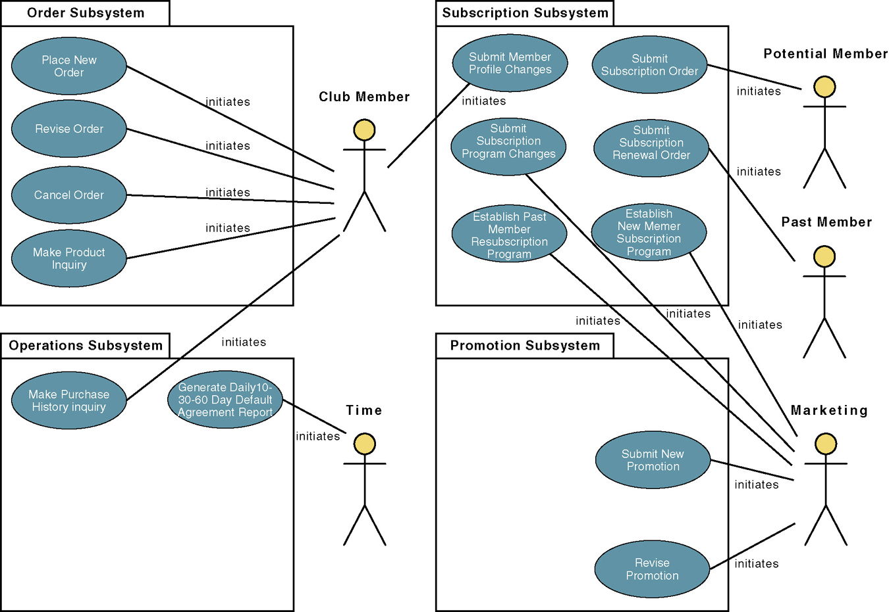
Another example: Use-Case Model Diagram
‹#›
Notes:
‹#›

Slide 25
Document Business Requirements Use-Case Narratives
Document first at high level to quickly obtain an understanding of the events and magnitude of the system.
Then expand to a fully-documented business requirement narrative.
Include the use case’s typical course of events and its alternate courses.
‹#›
Notes:
‹#›

Slide 26
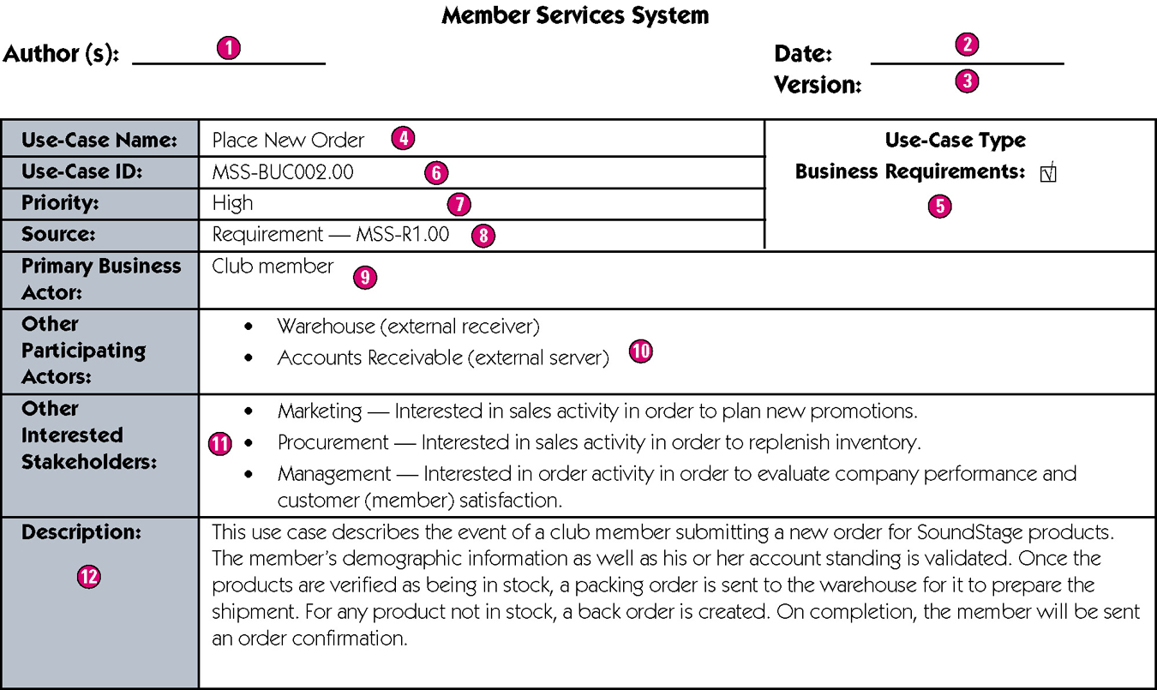
Sample High-Level Version of a Use-Case Narrative
‹#›
Notes:
‹#›
Teaching Notes
Author – the persons who wrote the use case and provide a point of contact for anyone requiring additional information.
Date – the date the use case was last modified.
Version – the current version of the use case.
Use-case name – the use-case name should represent the goal that the use case is trying to accomplish. Should begin with a verb.
Use-case type – Business requirements use cases provide a general understanding of the problem domain and scope but don’t include detail to communicate to developers what the system should do.
Use-case ID – A unique identifier for the use case.
Priority – The priority communicates the importance of the use case (high, medium, or low).
Source – The source defines the entity that triggered the creation of the use case.
Primary business actor – The stakeholder that primarily benefits from the execution of the use case.
Other participating actors – Other actors that participate in the use case.
Interested stakeholders – A person (other than the actor) who has a vested interest in the goal of the use case.
Description – A short summary description of the purpose of the use case and its activities.

Slide 27
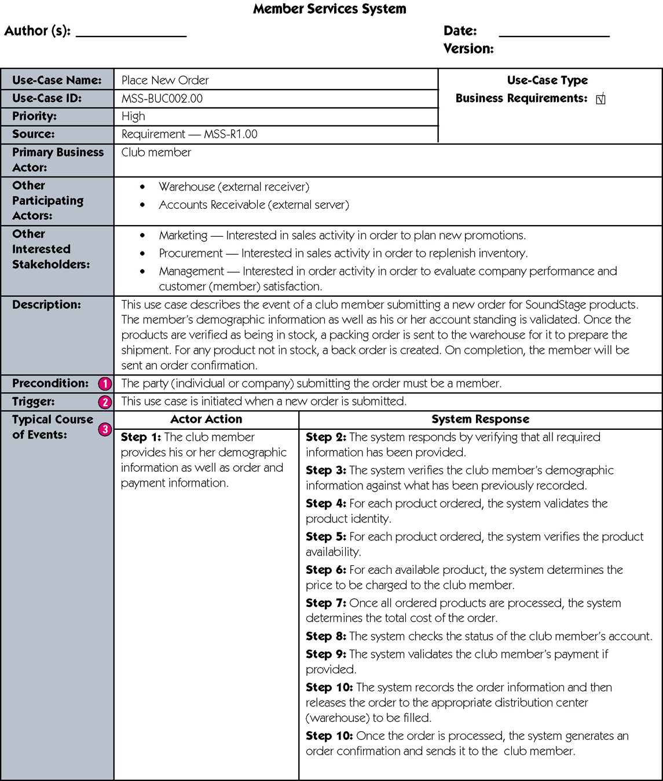
Sample Expanded Version of a Use-Case Narrative
continued
‹#›
Notes:
‹#›
Teaching Notes
Precondition – A constraint on the state of the system before the use case can be executed.
Trigger – The event that initiates the use case.
Typical course of events – The normal sequence of activities performed by the actor(s) and the system to satisfy the goal of the use case.
Alternate courses – The behaviors of the use case if an exception or variation to the typical course occurs.
Conclusion – When the use case successfully ends.
Postcondition – A constraint on the state of the system after the use case has successfully executed.
Business rules – Policies and procedures of the business that the system must abide by.
Implementation constraints and specifications – Any nonfunctional requirements that may impact the realization of the use case.
Assumptions – Assumptions made by the author.
Open issues – Issues that need to be resolved before the use case can be finalized.

Slide 28
Sample Expanded Version of a Use-Case Narrative (cont)
continued
‹#›
Notes:
‹#›
Teaching Notes
Precondition – A constraint on the state of the system before the use case can be executed.
Trigger – The event that initiates the use case.
Typical course of events – The normal sequence of activities performed by the actor(s) and the system to satisfy the goal of the use case.
Alternate courses – The behaviors of the use case if an exception or variation to the typical course occurs.
Conclusion – When the use case successfully ends.
Postcondition – A constraint on the state of the system after the use case has successfully executed.
Business rules – Policies and procedures of the business that the system must abide by.
Implementation constraints and specifications – Any nonfunctional requirements that may impact the realization of the use case.
Assumptions – Assumptions made by the author.
Open issues – Issues that need to be resolved before the use case can be finalized.

Slide 29
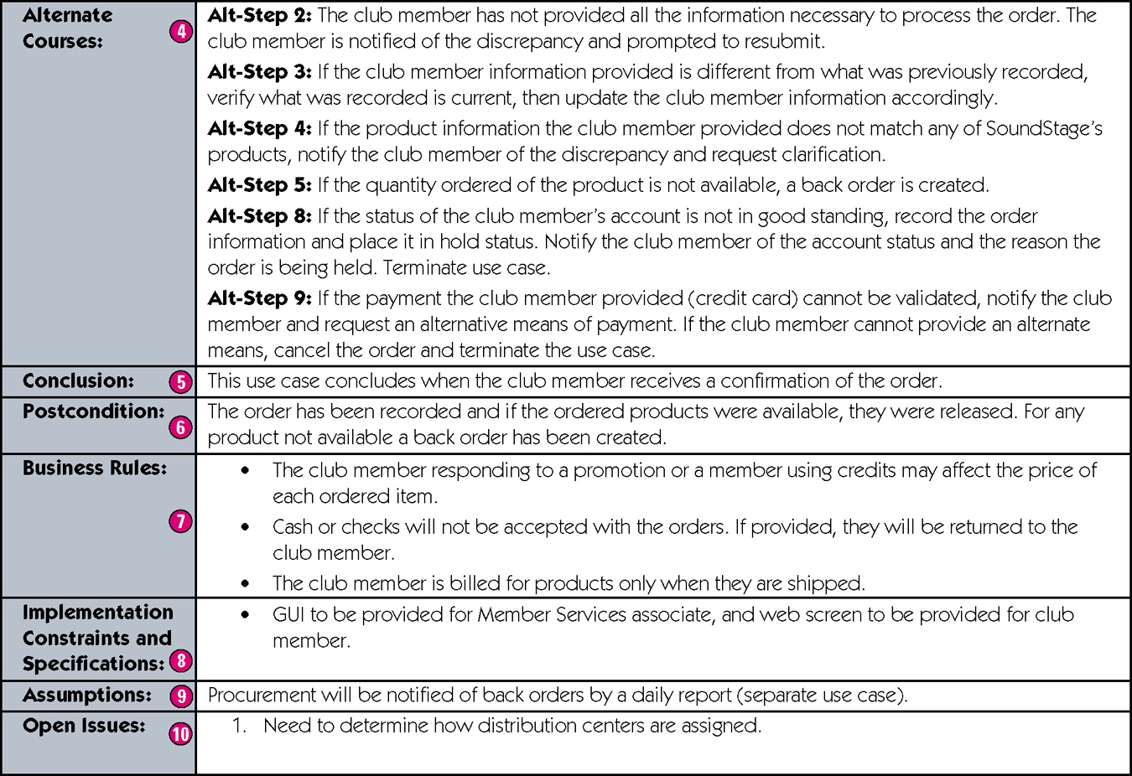
Sample Expanded Version of a Use-Case Narrative (cont)
‹#›
Notes:
‹#›
Teaching Notes
Precondition – A constraint on the state of the system before the use case can be executed.
Trigger – The event that initiates the use case.
Typical course of events – The normal sequence of activities performed by the actor(s) and the system to satisfy the goal of the use case.
Alternate courses – The behaviors of the use case if an exception or variation to the typical course occurs.
Conclusion – When the use case successfully ends.
Postcondition – A constraint on the state of the system after the use case has successfully executed.
Business rules – Policies and procedures of the business that the system must abide by.
Implementation constraints and specifications – Any nonfunctional requirements that may impact the realization of the use case.
Assumptions – Assumptions made by the author.
Open issues – Issues that need to be resolved before the use case can be finalized.

